Slide 1
Implementing Algorithms
Donald J. Santos, February 2018

Slide 2
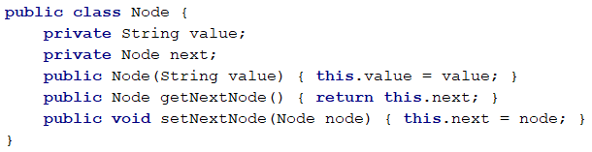
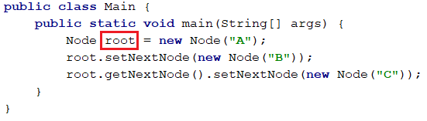
Linked List Data Structure
Value
A
Value
B
Value
C
root
●
Next
●
Next
●
Next
●

Slide 3
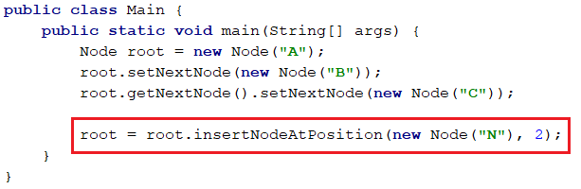
Insert Node Example
0
1
3
Value
A
Value
B
Value
C
root
●
Next
●
Next
●
2
Next
Value
N
Next
●

Slide 4
Step 1.) Define Single Example
0
1
2
Value
A
Value
B
Value
C
root
●
Next
●
Next
●
Next
Value
N
Next
●
We want to insert Node N to be at position 2.
We need access to Node B, which is at position 1.
Set Node N.Next to point to Node C, which is Node B.Next.
Set Node B.Next to point to Node N.

Slide 5
Step 2.) Define General Case
0
1
2
Value
A
Value
B
Value
C
root
●
Next
●
Next
●
Next
Value
N
Next
●
We want to insert Node N to be at position i.
We need access to the Node (P) at position i-1.
Set Node N.Next to point to Node P.Next.
Set Node P.Next to point to Node N.

Slide 6
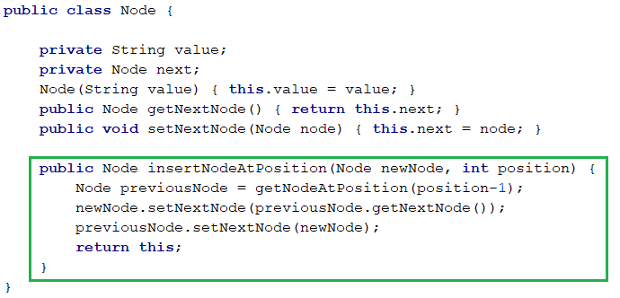
Step 3.) Implement General Case
We want to insert Node N to be at position i.
We need access to the Node (P) at position i-1.
Set Node N.Next to point to Node P.Next.
Set Node P.Next to point to Node N.

Slide 7
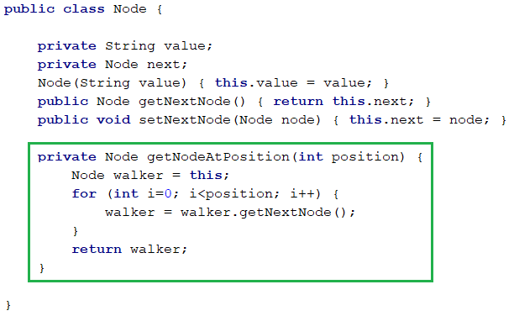
Step 4.) Implement Subroutines
getNodeAtPosition(i)
Create a “walker” Node that has the same value as the root.
Iterate i times executing: walker = walker.Next

Slide 8
Step 5.) Implement Edge Cases
Edge Case 1: Insert At End Of List
New Subroutine append
Edge Case 2: Insert At Position 0
New Subroutine newRoot

Slide 9
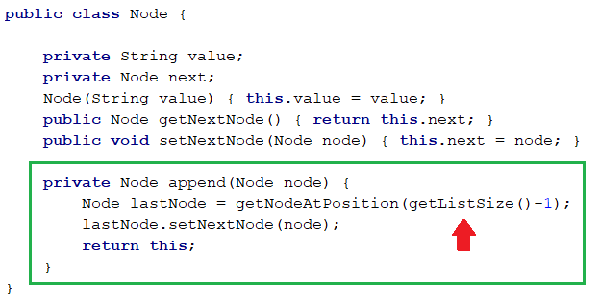
Step 5.) Implement Edge Cases
append
Get the last node in the list.
Set LastNode.Next to the node to be appended.

Slide 10
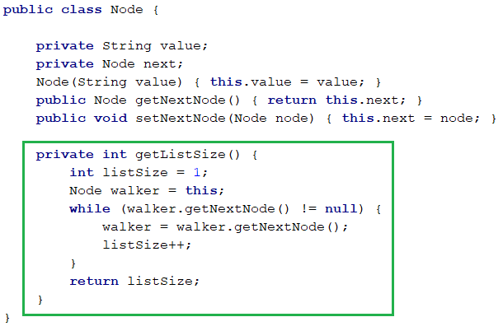
Step 5.) Implement Edge Cases
getListSize()

Slide 11
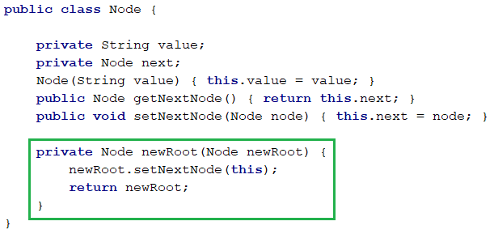
Step 5.) Implement Edge Cases
newRoot
Set the new root node Next to the current root.
Return the newRoot so you can re-assign the root reference.

Slide 12
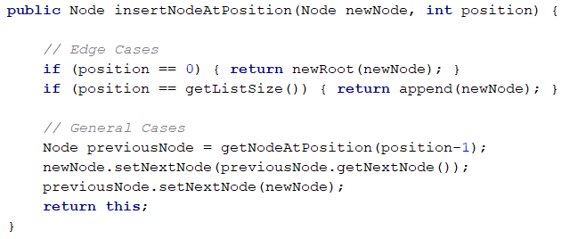
Step 6.) Complete The Algorithm

Slide 13
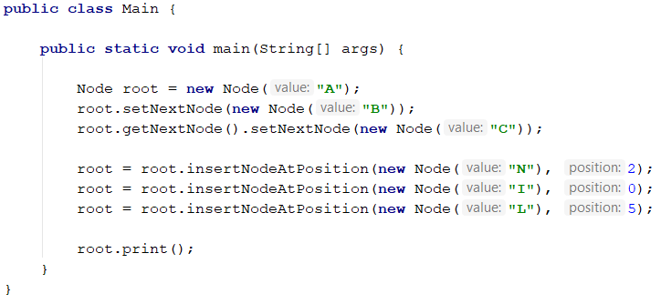
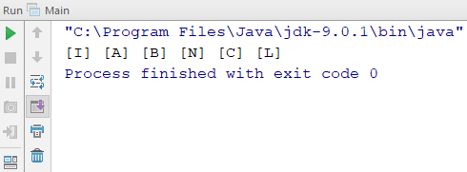
Step 7.) Compose And Test

Slide 14

See You Later !

